Slide 1
ICT in IBSE How to implement?

Slide 2
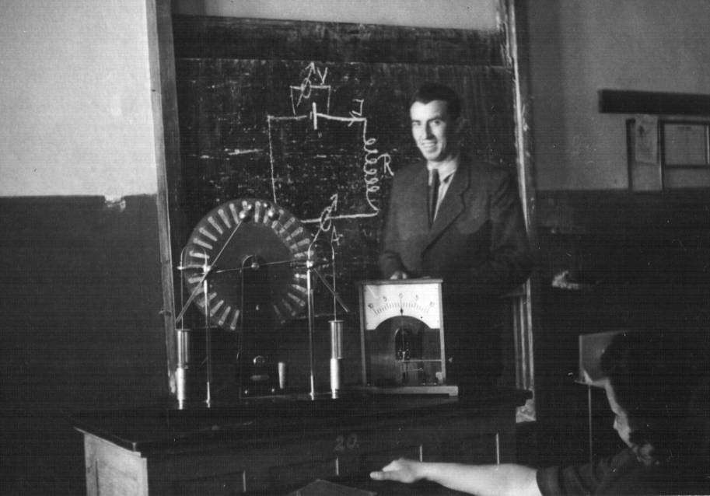
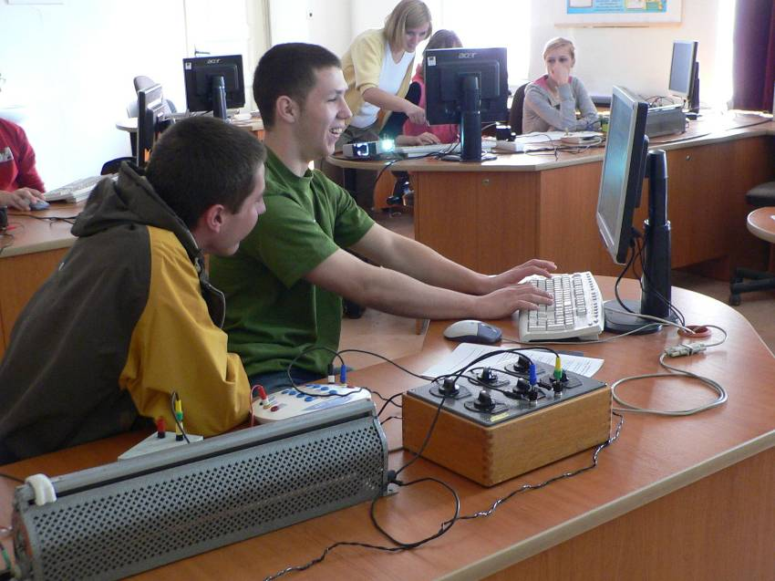
Science Education now!
Has anything changed in Science Education?
Think about the differences in Science Teaching and Learning in the past and now.

Slide 3
IBSE
What skills students need to do inquiry?
What skills teacher needs to do inquiry?
Can ICT encourage and support IBSE approach?

Slide 4
ICT in IBSE
ICT tools are central to the nature of scientists work.
Scientists choose a research problem or form a hypothesis, design and carry out experiments, and analyse the results using processing software.
Scientists create theoretical models to support the experimental results
Scientists search for information and communicate their findings.
ICT in IBSE - adaptation from research use of the same technology for similar tasks and hence it supports and enhances scientific inquiry.

Slide 5
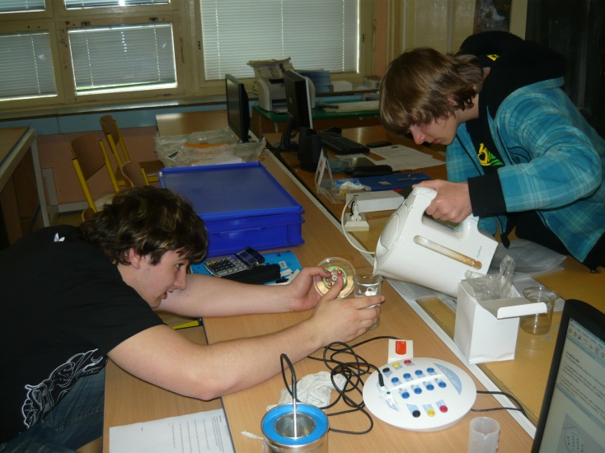
What are the educational benefits? Data Logging
The rate of data collection is available over the wide range of time and sampling frequencies
Presenting data while being collected allows making immediate observation of the data and reinforces the link between an experiment and its results, hence it enhances graph understanding
Immediate feedback encourages critical thinking skills; students have more time to spend on observing and interpreting, discussing and analysing data
Students are actively involved in the learning process by having the control to make their own investigations
Enhance conceptual understanding
Discuss each of the benefits and give examples.

Slide 6
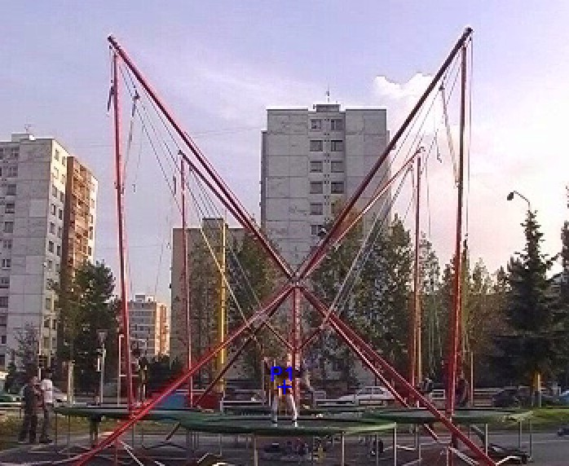
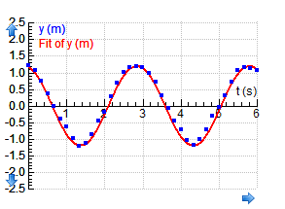
What are the educational benefits? Video/Image Measurement
Allows to analyze real events, which happen outside the classroom.
Enables to bring attractive situations into the class
Graphs are synchronized with the video frames. This helps students to bridge the concrete visual display of a motion event and its abstract graphical representation
Supports graph understanding
Enables deeper understanding of motion
Discuss each of the benefits and give examples.

Slide 7
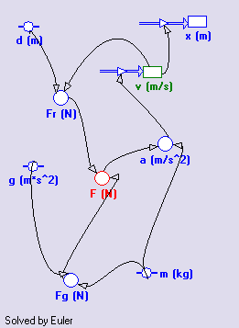
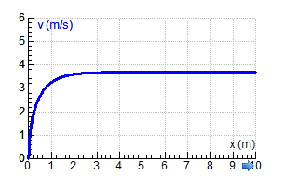
What are the educational benefits? Modelling
Allows to solve complex and realistic problems, not just limited to ideal situations
Helps to enhance student’s theory building abilities
Model structure is easy to modify allowing trying different ideas
Models can be used to predict different situations
Allows to compare theoretical models with experimental results
Emphasizes validation of work and develops a critical attitude by working with several models for one and the same phenomenon
Discuss each of the benefits and give examples.

Slide 8
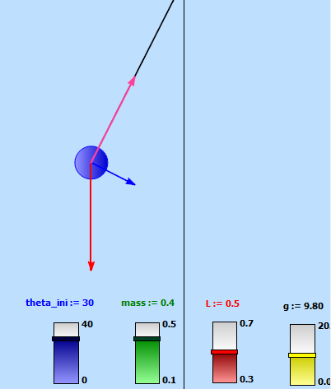
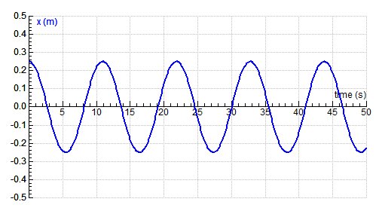
What are the educational benefits? Animations/Simulation
Another way of representing data, next to digital and analogue meters, graphs and tables
Helps students to better understand the underlying principles of the phenomenon
Stimulates students to acquire and use new skills such as:
comparing representations in order to get better understanding of the more abstract ones
making and testing hypotheses about different representations.
Discuss each of the benefits and give examples.

Slide 9
Efficiency of ICT tools
Depends on the way they are implemented:
Learning through Active Engagement use activity-based curricular materials
Learning through Participation in Groups use peer instruction and collaborative work
Learning through Frequent Interaction and Feedback use learning cycle with predictions
Discuss these principles.
Roschelle, J. et al. Changing How and What children learn in school with Computer-Based technologies,
The future of Children and Computer Technology, vol.10, No.1, 2000,76-101

Slide 10
Role of teacher
Understanding of the special value of the ICT method and exploiting its full potential in purposeful ways for learning
Creating conditions for proper use of ICT, managing activities in a way which promotes ‘appropriate’ rather than ‘indiscriminate’ use of ICT
Integrating the learning from each activity to facilitate the development of students’ understanding and IBSE skills
Designing activities which sets students at the center of processes as autonomous learners or where they can share active participation (classroom settings important)
Discuss these aspects and reflect upon your teaching experience.

Slide 11
Summary
ICT tools with its constructional side
– if used properly – enhance IBSE:
Actively engage students in constructing science concepts
Enhance and complement science teaching instruction
Allow for collection, graphing, interpretation and analyses of data
Students work with high-quality, real time data in much the same way as professionals do
Bridge the gap to real life context

Slide 12
Summary
ICT tools with its constructional side
– if used properly – enhance IBSE:
Allow students to use more powerful and sophisticated techniques that more realistically reflect methods used in research
Provide opportunities to predict, question and apply science concepts
Enhance hands-on interactive learning
Make more efficient use of limited class time

Slide 13
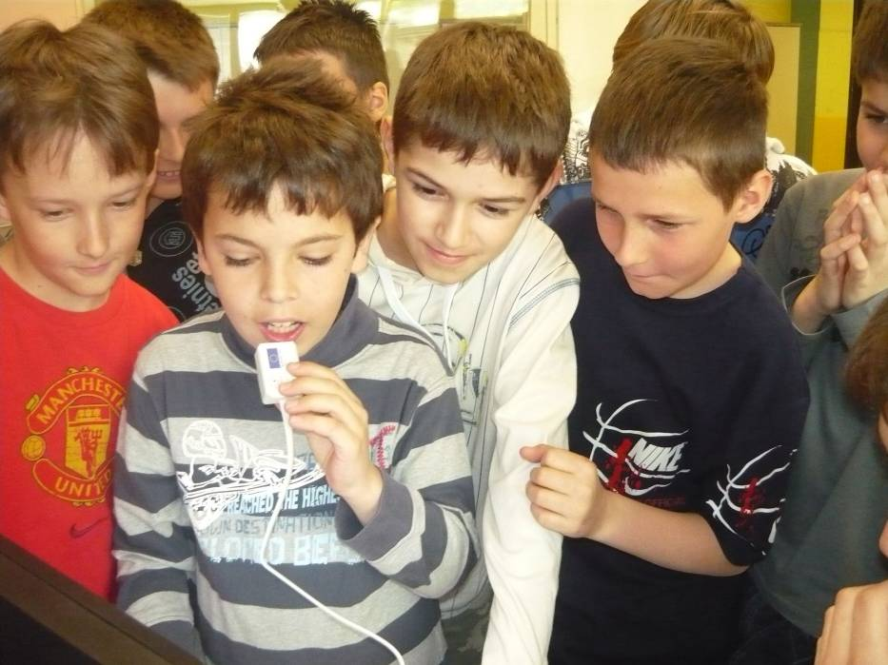
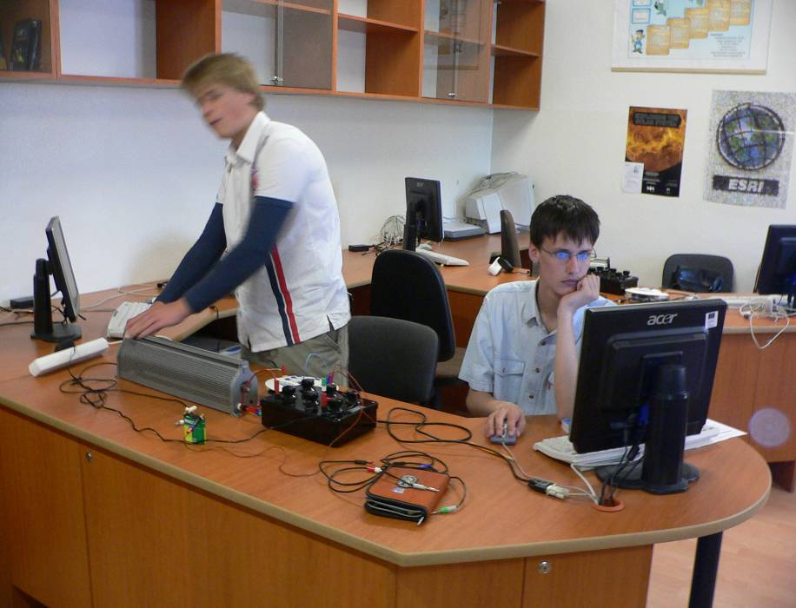
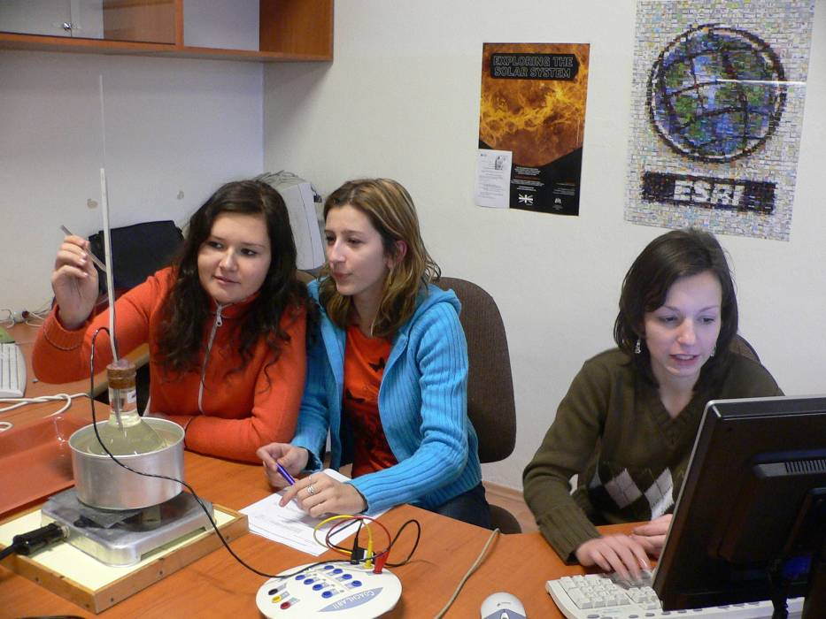
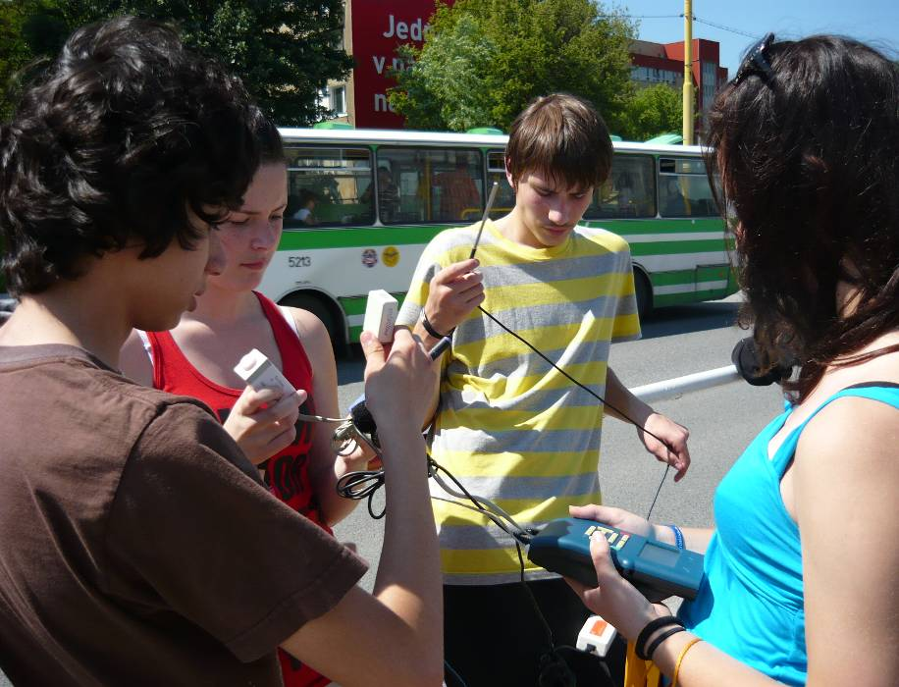
Think about your class and discuss the implementation of IBSE approach in your context. Consider the difficulties you may come across while implementing IBSE methods enhanced by ICT tools.

