Slide 1
Information and Communication Technology for
Inquiry Based Science Education

Slide 2
Educational software
Constructional
wing
Informational
wing
Processing Information
- ICT serves as a tool
for constructing
new information and understanding
Presenting Information
- ICT facilitates novel methods of examining ready accumulated information
Papert, 1999 Introduction in: Logo Philosophy and Implementation

Slide 3
Educational software
Constructional
wing
Informational
wing
Data logging
Data processing
Video measurement
Modelling
Simulation
Internet
Multimedia
Visualisation
Instruction and tutorial

Slide 4
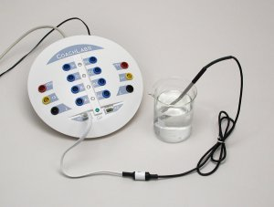
Data Logging
Process of collecting data over a period of time via
(a stand-alone or connected to the computer) data-logger and sensors.
Dedicated data-logging software allows to:
control the process of data collection,
monitor the data collected by linked sensors,
graph the real-time collected data,
analyze and process the data
store the data.

Slide 5
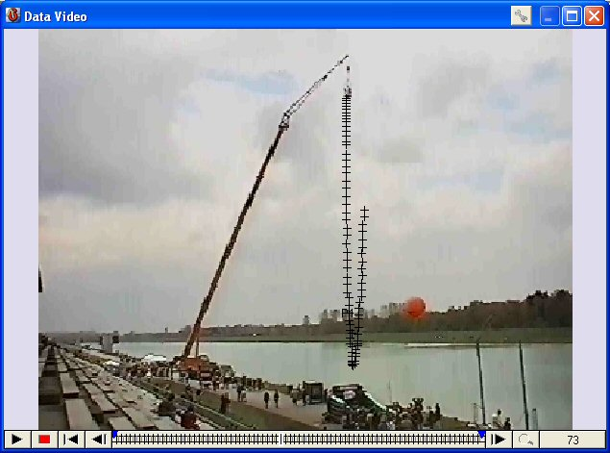
Video Measurement
Process of collecting data from digital video clips or digital images.
During measurements on video clips, position and time data are collected in the selected video frames,
manually by clicking or automa-tically by tracking a moving object.
During measurements on a single image, position data, or position
and time data for stroboscopic images, are collected by clicking points of interest in an image.
The collected data are displayed on graphs and can be used for further analysis and processing.

Slide 6
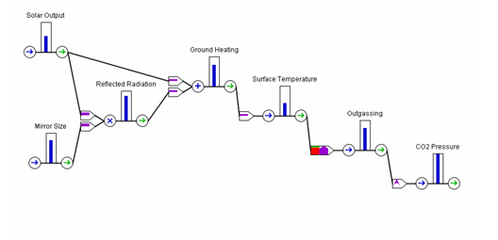
Modeling
Process of using and creating numerical models of dynamical processes and system.
In such models the dynamic change is described step-by-step.
Model structure is built with symbols and gives a visual representation of model variables and interactions.
The relation between model variables are described by mathematical expressions.

Slide 7
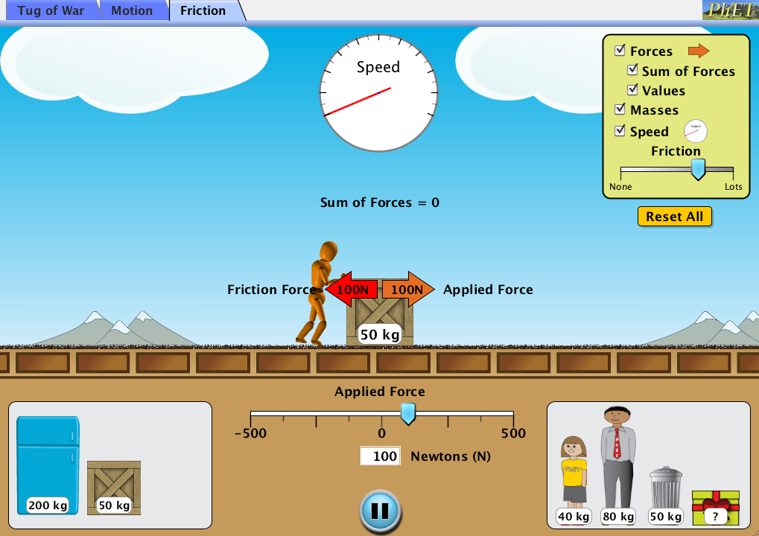
Simulation
Process of using models to identify and understand those factors which control the system and/or
to predict the future behavior of the system.
Simulations are often specific, designed to represent
a particular phenomena.
Usually do not provide access to “built-in” mathematical model.
It is effectively used for demonstrating concepts or systems which can not be directly experienced

Slide 8
For IBSE!
These ICT tools, when used in a proper way, can encourage an inquiry-based approach to science by:
facilitating active and independent student learning
encouraging students collaboration
providing research tools which resemble tools and technologies used by “real” scientists
showing authentic, real-life applications
creating positive attitudes towards science

